Slide 1
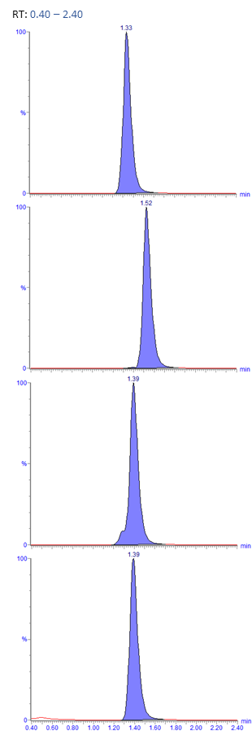
Supplementary Figure 1
Lab A
Lab B
Lab C
Lab D
Lab E
Lab F
LPC(16:0)
LPC(18:0)
LPC(18:1)
IS
Chromatograms of LPCs in all laboratories in the present study.

