Slide 1
Donor Number | Brain bank | Status | Sex | Age | Braak | Amyloid | PMD | pH | Diagnosis | DSM comorbidity | Other comorbidities | Cause of death | Smoking | Alcohol | Methylation | qPCR
1 | NBB | CTR | F | 87 | 2 | x | 8.0 | 6.9 | Non- Demented CTR | x | 6 | 2 | x | x | x | x
2 | NBB | CTR | M | 84 | 1 | x | 9.0 | 6.2 | Non- Demented CTR | x | 4;5;6 | 2 | Yes | 2 | x | x
3 | NBB | CTR | M | 51 | 0 | x | 7.7 | x | Non- Demented CTR | x | 6 | x | x | x | x | x
4 | NBB | CTR | M | 78 | 1 | O | 17.7 | 6.5 | Non- Demented CTR | No | 6;7;8 | 2 | No | No | x | x
5 | NBB | CTR | F | 71 | 1 | A | 7.2 | 6.3 | Non- Demented CTR | No | 3a;6;8 | 4 | Yes | x | x | x
6 | NBB | CTR | M | 92 | 4 | A | 8.4 | 6.1 | Non- Demented CTR | No | 7;8 | 2 | No | No | x | x
7 | NBB | CTR | F | 81 | 1 | O | 4.4 | 6.7 | Non- Demented CTR | No | 6;7;8 | 4 | No | No | x | x
8 | NBB | CTR | F | 91 | 1 | B | 4.3 | 6.5 | Non- Demented CTR | No | 1; 3a+c; 8 | 2 | No | No | x | x
9 | NBB | CTR | M | 51 | 0 | O | 7.8 | 7.1 | Non- Demented CTR | 4 | 1; 7 | 3 | No | No | x | x
10 | NBB | CTR | F | 89 | 2 | B | 5.7 | 6.8 | Non- Demented CTR | No | 6;1 | 2 | x | x | x | x
11 | NBB | CTR | F | 84 | 2 | A | 5.6 | 6.7 | Non- Demented CTR | No | 3d; 4 | 2 | Yes | No | x | x
12 | EBTB | CTR | M | 79 | x | x | 73 | 6.9 | Non-Demented CTR | x | x | 2 | x | x |  | x
13 | EBTB | CTR | M | 50 | x | x | 103 | 5.7 | Non-Demented CTR | x | x | 2 | x | x |  | x
14 | EBTB | CTR | M | 45 | x | x | 74 | 6.6 | Non-Demented CTR | x | x | 2 | x | x |  | x
15 | NBB | SCZ | F | 85 | 2 | x | 9.0 | x | Schizophrenia (catatonic) | 3 | 6;8 | 2 | No | No | x | x
16 | NBB | SCZ | M | 76 | 0 | x | 89.0 | x | Schizophrenia (catatonic) | 1 | 4;5;6;8 | 2 | Yes | 2 | x | x
17 | NBB | SCZ | M | 67 | 1 | A | 65.0 | x | Schizophrenia (apathic defect) | 3 | 4;5;6;8 | 1;2 | Yes | x | x | x
18 | NBB | SCZ | M | 78 | 1 | B | 3.3 | x | Schizophrenia (paranoid) | x | 5;6 | 2 | Yes | x | x | x
19 | NBB | SCZ | M | 59 | x | x | 12.5 | 5.9 | Schizophrenia (paranoid) | x | 6;7 | 2 | No | No | x | x
20 | NBB | SCZ | M | 64 | 1 | A | 19.3 | 7 | Schizophrenia (paranoid) | No | 8 | 2 | No | No | x | x
21 | NBB | SCZ | F | 79 | 1 | x | 4.8 | 6.3 | Schizoafective disorder | 1;5 | 6 | 2 | No | No | x | x
22 | NBB | SCZ | F | 63 | x | x | 5 | 6.5 | Schizophrenia (paranoid) | No | 4 | 1 | x | x | x | x
23 | NBB | SCZ | F | 92 | x | x | 7.6 | 6.3 | Schizophrenia (paranoid) | 1 | 8 | 2 | x | x | x
24 | EBTB | SCZ | M | 70 | x | x | 45 | 6.3 | Schizophrenia | x | 8 | 2 | x | x |  | x
25 | EBTB | SCZ | M | 50 | x | x | 75 | 6.1 | Schizophrenia | x | x | 2 | x | x |  | x
26 | EBTB | SCZ | M | 44 | x | x | 44 | 6.4 | Schizophrenia | x | x | 2 | x | x |  | x
Supplementary table 1: Extended clinocopathological information of donors. NBB = Netherlands Brain Bank; EBTB = Edinburgh Brain and Tissue Bank; CTR = control donor; SCZ = schizophrenia donor; F = female; M = male; PMD = post-mortem delay; DSM comorbidity: 1 = mood disorder (bipolar/depression); 2 = addiction; 3 = (moderate) intellectual disability; 4 = anxiety; 5 = personality disorder. Other comorbidities: 1 = infection; 2 = auto immune disease; 3 = neurological (a: CVA, b: cancer, c: delirium, d: tia); 4 = cancer; 5 = COPD; 6 = cardiovascular disease; 7 = diabetes; 8 = other . Cause of death: 1 = cancer; 2 = cardiorespiratory; 3 = suicide; 4 = other (renal insufficiency, intestinal ischemia). Alcohol: 1 = 1-5 units a day; 2 = more than 5 units a day. Methylation: included in DNA methylation analysis. qPCR: included in gene-expression analyses. x = not available; NA = not applicable.

Slide 2
Primer | Forward sequence | Reverse sequence
KLF9 | CAGTGGCTGTGGGAAAGTCTA | CCGTTCACCTGTATGCACTCTG
SFXN1 | GAAGAGGTTCCCATGGATGA | TCAGGATGGCTCTCTTGGAT
SPRED2 | ACACACCCAGACGATGACAG | CCTTCCTGTGGGAACCATCC
GAPDH | TGCACCACCAACTGCTTAGC | GGCATGGACTGTGGTCATGA
SDHA | GAAGCCCTTTGAGGAGCACT | GTTTTGTCGATCACGGGTCT
Supplementary table 2: Primers sequences for qPCR analyses.

Slide 3
Donor | Status | Tissue | CT Geomean
1 | CTR | GFM Grey | 20.80
2 | CTR | GFM Grey | 20.09
4 | CTR | GFM Grey | 21.51
6 | CTR | GFM Grey | 19.11
7 | CTR | GFM Grey | 20.47
8 | CTR | GFM Grey | 19.08
9 | CTR | GFM Grey | 19.03
10 | CTR | GFM Grey | 18.61
11 | CTR | GFM Grey | 19.58
1 | CTR | GTS Grey | 19.40
2 | CTR | GTS Grey | 25.05
3 | CTR | GTS Grey | 21.30
4 | CTR | GTS Grey | 19.97
5 | CTR | GTS Grey | 18.96
6 | CTR | GTS Grey | 22.19
7 | CTR | GTS Grey | 18.41
8 | CTR | GTS Grey | 22.07
9 | CTR | GTS Grey | 21.76
10 | CTR | GTS Grey | 22.36
11 | CTR | GTS Grey | 19.63
12 | CTR | GTS Grey | 24.12
13 | CTR | GTS Grey | 23.83
14 | CTR | GTS Grey | 21.11
2 | CTR | GFM White | 21.13
6 | CTR | GFM White | 20.66
7 | CTR | GFM White | 20.46
8 | CTR | GFM White | 20.12
9 | CTR | GFM White | 20.17
10 | CTR | GFM White | 19.71
11 | CTR | GTS White | 24.46
3 | CTR | GTS White | 20.79
4 | CTR | GTS White | 21.57
5 | CTR | GTS White | 19.46
6 | CTR | GTS White | 23.03
7 | CTR | GTS White | 19.02
8 | CTR | GTS White | 21.77
9 | CTR | GTS White | 21.84
11 | CTR | GTS White | 21.31
12 | CTR | GTS White | 25.11
13 | CTR | GTS White | 25.70
14 | CTR | GTS White | 22.60
Donor | Status | Tissue | CT Geomean
15 | SCZ | GFM Grey | 22.13
16 | SCZ | GFM Grey | 18.00
17 | SCZ | GFM Grey | 18.83
18 | SCZ | GFM Grey | 21.16
19 | SCZ | GFM Grey | 21.51
20 | SCZ | GFM Grey | 20.95
22 | SCZ | GFM Grey | 20.61
15 | SCZ | GTS Grey | 20.15
17 | SCZ | GTS Grey | 19.59
18 | SCZ | GTS Grey | 24.94
19 | SCZ | GTS Grey | 24.02
20 | SCZ | GTS Grey | 24.69
21 | SCZ | GTS Grey | 24.16
22 | SCZ | GTS Grey | 24.96
24 | SCZ | GTS Grey | 23.67
25 | SCZ | GTS Grey | 22.39
26 | SCZ | GTS Grey | 23.74
15 | SCZ | GFM White | 21.37
16 | SCZ | GFM White | 18.64
17 | SCZ | GFM White | 27.71
18 | SCZ | GFM White | 19.00
19 | SCZ | GFM White | 21.71
20 | SCZ | GFM White | 18.91
21 | SCZ | GFM White | 19.06
22 | SCZ | GFM White | 19.45
17 | SCZ | GTS White | 19.07
18 | SCZ | GTS White | 20.49
21 | SCZ | GTS White | 22.19
22 | SCZ | GTS White | 23.73
24 | SCZ | GTS White | 23.11
26 | SCZ | GTS White | 24.15
Supplementary table 3: Geomean of raw CT values of reference genes beta-actin (βactin), Glyceraldehyde 3-phosphate dehydrogenase (GAPDH) and Succinate Dehydrogenase Complex Flavoprotein Subunit A (SDHA) for each donor and each tissue included in the gene-expression analysis.

Slide 4
 |  | Sex |  | Age |  | PMD |  | pH |  | Braak-score
 |  | U | N | r | N | r | N | r | N | kw | N
qPCR | KLF9 | 343 | 57 | 0.1163 | 57 | -0.04085 | 57 | -0.1572 | 42 | 3.702 | 50
qPCR | SFXN1 | 308 | 57 | 0.04717 | 57 | -0.05572 | 57 | -0.07042 | 42 | 4.43 | 50
qPCR | SPRED2 | 265.5 | 57 | -0.02193 | 57 | 0.06606 | 57 | -0.1502 | 42 | 2.961 | 50
Supplementary table 4: Associations between potential confounding variables sex, age, PMD, pH, Braak-score for gene-expression data. The number of samples included (N), Spearman rho correlation (r) or Kruskal Wallis test statistic (kw) for the potential confounding variables (sex, age, post-mortem delay (PMD), pH, Braak-score) and each outcome gene. There were no significant effects after Bonferroni correction for multiple testing (p < 0.05).

Slide 5
Supplementary figure 1: QQ plot of the p-values from discovery EWAS.

Slide 6
Genetic location DMR | Annotated Gene ID (hg37) | Gene symbol | ß (Beta) | t-value | p-value
22:46330705-46330821 | ENSG00000188064.9 | WNT7B | -0.032 | -4.19 | 6.629622e-06
17:47651453-47651470 | ENSG00000250310.1 | RP5-1029K10.4 | -0.046 | -4.38 | 2.847938e-05
16:29832601-29832769 | ENSG00000013364.18 | MVP | 0.033 | 3.29 | 1.966789e-06
15:101401957-101402037 | ENSG00000272808 | RP11-66B24.7 | -0.030 | -3.29 | 7.461466e-06
12:99548301-99548550 | ENSG00000185046.18 | ANKS1B | -0.044 | -4.04 | 5.747834e-09
11:10674645-10674966 | ENSG00000072952 | MRVI1 | -2.73e-02 | -2.67 | 2.835480e-03
11:110001379-110001680 | ENSG00000149289 | ZC3H12C | -0.038 | -3.41 | 7.274794e-06
10:23540118-23540223 | ENSG00000179133.12 | C10orf67 | -0.050 | -4.33 | 7.967646e-05
9:73034238-73034460 | ENSG00000119138.4 | KLF9 | -0.014 | -4.76 | 2.418027e-06
6:22147182-22147502 | ENSG00000260455.1 | CASC15 | -0.022 | -3.37 | 2.585906e-05
6:33290601-33290648 | ENSG00000204209 | DAXX | -0.011 | -2.55 | 3.628941e-05
6:151670624-151670725 | ENSG00000131016.16 | AKAP12 | 5.15e-02 | 4.21 | 8.959884e-06
5:14957124-14957231 | ENSG00000250247.1 | SEPHS2P1 | -4.87e-02 | -4.19 | 1.603855e-05
5:92909429-92909434 | ENSG00000237187.8 | NR2F1-AS1 | 0.032 | 3.38 | 3.142746e-05
5:148799955-148800342 | ENSG00000249669.9 | MIR143HG | 4.31e-02 | 4.38 | 4.839460e-07
5:170042332-170042392 | ENSG00000182132.13 | KCNIP1 | -0.025 | -3.83 | 4.991935e-06
5:174944792-174944864 | ENSG00000164466.12 | SFXN1 | -3.11e-02 | -4.24 | 2.930616e-05
3:8811728-8811758 | ENSG00000182533.6 | OXTR | -0.019 | -1.63 | 3.008513e-02
3:46734995-46735009 | ENSG00000178038.16 | ALS2CL | 4.12e-02 | 3.51 | 3.506822e-06
2:65540924-65541060 | ENSG00000198369.9 | SPRED2 | -0.019 | -3.76 | 2.399794e-04
2:74775957-74776131 | ENSG00000115325.13 | DOK1 | 0.016 | 3.61 | 8.896379e-07
2:197953651-197953693 | ENSG00000065413.18 | ANKRD44 | -0.038 | -2.87 | 2.040158e-04
2:237542624-237542706 | ENSG00000144476 | ACKR3 | -0.030 | -3.68 | 3.984192e-06
1:24829987-24830054 | ENSG00000117602.11 | RCAN3 | 0.043 | 4.29 | 2.037072e-04
Supplementary table 5: Results of the linear mixed-effects model of DNA methylation and the interaction term. The table shows the interaction term of the 24 DMRs that showed differential methylation between grey vs. white matter in SCZ (N = 9) compared to CTR (N = 11) donors in the gyrus frontalis medialis and gyrus temporalis superior. The β-value represents the log2 of the methylation percentage (0 = unmethylated, 1 = completely methylated). The significance level was set to p < 0.0001.

Slide 7
DMR | SCZ |  | Control
 | White | Grey | White | Grey
WNT7B | 0.55278830 | 0.49253303 | 0.58003060 | 0.48506775
RP5-1029K10.4 | 0.15028505 | 0.28520175 | 0.16933440 | 0.26650443
MVP | 0.41894418 | 0.50139577 | 0.38446605 | 0.50385497
RP11-66B24.7 | 0.22205983 | 0.41063490 | 0.21209032 | 0.37522965
ANKS1B | 0.13881316 | 0.23083198 | 0.14736455 | 0.19261439
MRVI1 | 0.76472890 | 0.74986473 | 0.78759319 | 0.74716896
ZC3H12C | 0.29043163 | 0.60177816 | 0.26888805 | 0.53897668
C10orf67 | 0.60602557 | 0.55107423 | 0.62624593 | 0.52009504
KLF9 | 0.03607445 | 0.05899374 | 0.04004173 | 0.04774784
CASC15 | 0.13644163 | 0.16052558 | 0.13464877 | 0.14092755
DAXX | 0.07311410 | 0.09411980 | 0.07217810 | 0.08092120
AKAP12 | 0.84750685 | 0.77200055 | 0.85051241 | 0.81801591
SEPHS2P1 | 0.50139549 | 0.65621374 | 0.50919449 | 0.61674781
NR2F1-AS1 | 0.86382530 | 0.77094462 | 0.86818640 | 0.80744139
MIR143HG | 0.82993500 | 0.70816815 | 0.83479216 | 0.75524132
KCNIP1 | 0.78211723 | 0.72960947 | 0.80509352 | 0.72837784
SFXN1 | 0.88367239 | 0.74302071 | 0.89762048 | 0.72312770
CAV3 | 0.15819939 | 0.25324981 | 0.15332267 | 0.22552742
ALS2CL | 0.02550929 | 0.04470503 | 0.01669881 | 0.07323349
SPRED2 | 0.94624059 | 0.93834735 | 0.94244050 | 0.91643863
DOK1 | 0.10381331 | 0.08966235 | 0.08347954 | 0.08717839
ANKRD44 | 0.15081254 | 0.27230592 | 0.13432471 | 0.22479731
ACKR3 | 0.93442306 | 0.90164730 | 0.93962540 | 0.87697427
RCAN3 | 0.28832943 | 0.37935403 | 0.24466904 | 0.38093685
Supplementary table 6: Mean methylation values. Methylation values per DMR of SCZ and CTR samples, separated for grey and white matter.

Slide 8
C
D
Supplementary figure 2: Genome information of the four DMRs of interest. Genomic information on the DMRs for (A) KLF9, (B) SFXN1, (C) SPRED2 and (D) ALS2CL were created using the UCSC genome browser. For each DRM, the ideogram is shown and the genomic data, containing information about this genomic region: genes, sites of transcription, methylation and acetylation marks, open chromatin and clinically relevant SNP’s. The specific location of the DMRs are indicated with red in the ideogram and the genomic data.
A
B

Slide 9
Tissue | Gene | N SCZ | Median SCZ | IQR SCZ | N CTR | Median CTR | IQR CTR | p value
GFM Grey | KLF9 | 7 | 391.8 | 438.6 | 9 | 977.6 | 421.2 | 0.0021
GFM White | KLF9 | 8 | 361.3 | 329.1 | 6 | 704.2 | 409.1 | 0.0127
GTS Grey | KLF9 | 10 | 473.9 | 316.1 | 14 | 289.1 | 268.8 | 0.0358
GTS White | KLF9 | 6 | 326.4 | 334.7 | 12 | 330.2 | 331.5 | 0.8916
GFM Grey | SFXN1 | 7 | 139.8 | 162.7 | 8 | 488.9 | 208.5 | 0.0022
GFM White | SFXN1 | 8 | 157.3 | 86.8 | 6 | 356.7 | 196.1 | 0.02
GTS Grey | SFXN1 | 10 | 155.3 | 143.6 | 14 | 102.6 | 76.46 | 0.2591
GTS White | SFXN1 | 6 | 153.3 | 153.3 | 12 | 109.5 | 46.5 | 0.0831
GFM Grey | SPRED2 | 7 | 154.7 | 199.78 | 9 | 282.3 | 279.3 | 0.1142
GFM White | SPRED2 | 7 | 98.6 | 44.9 | 6 | 193.8 | 70.3 | 0.0023
GTS Grey | SPRED2 | 10 | 150.6 | 93.5 | 12 | 104 | 168.1 | 0.1375
GTS White | SPRED2 | 6 | 146 | 100.8 | 11 | 77.84 | 140.3 | 0.4043
Supplementary table 7: Outcome variables for gene-expression data. The N, median relative expression, IQR (inter-quartile range, and p value from the Mann Witney U test is given for SCZ and CTR groups for each tissue (GFM/GTS and Grey/White) and each gene separately.

Slide 10
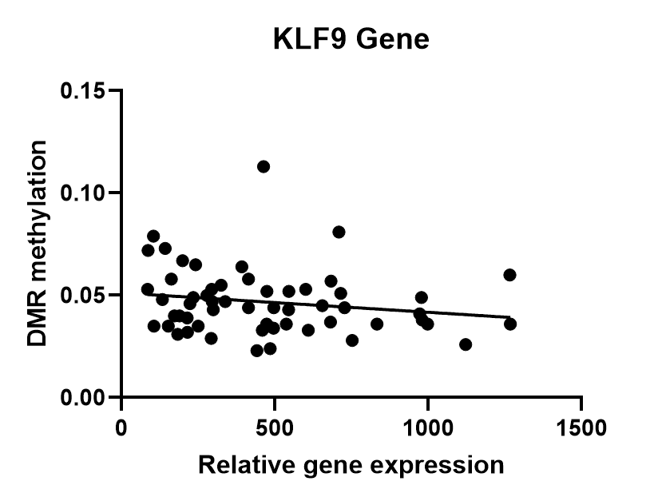
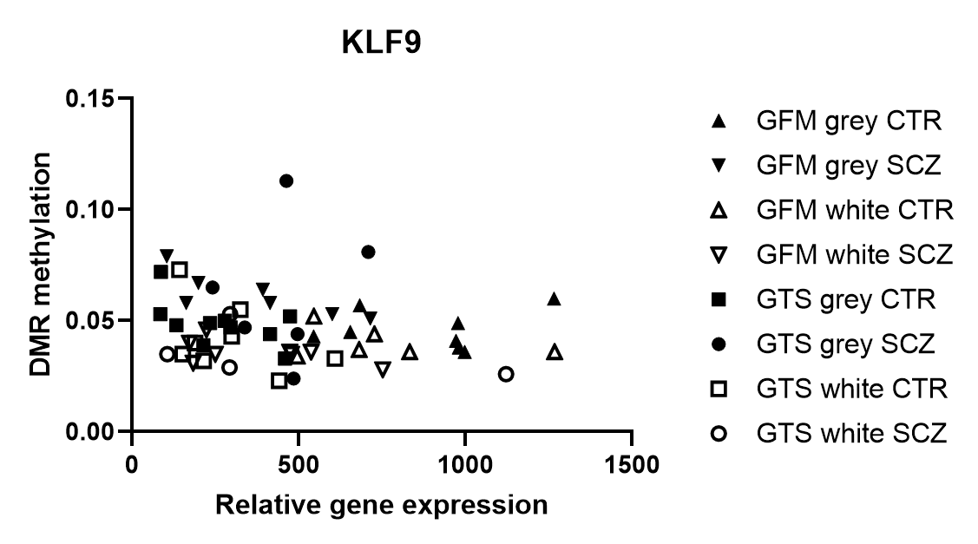
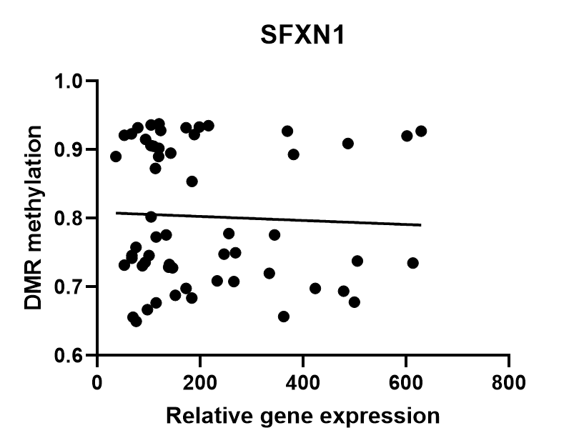
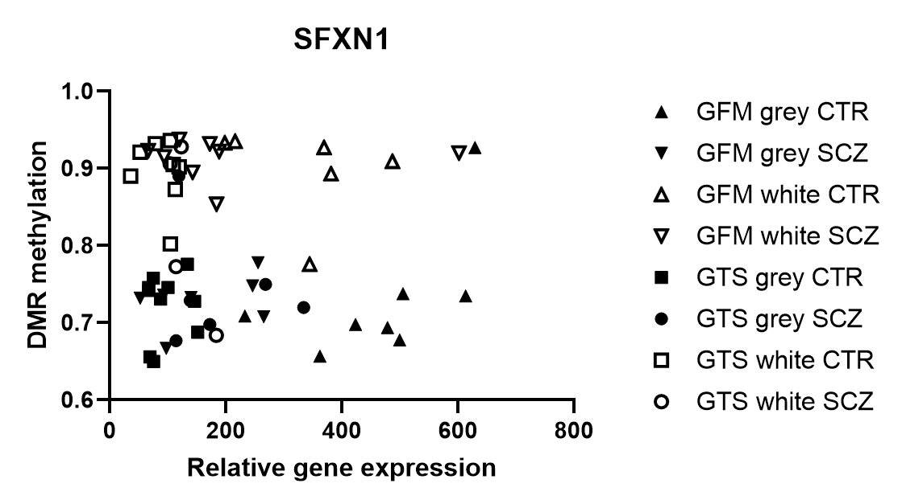
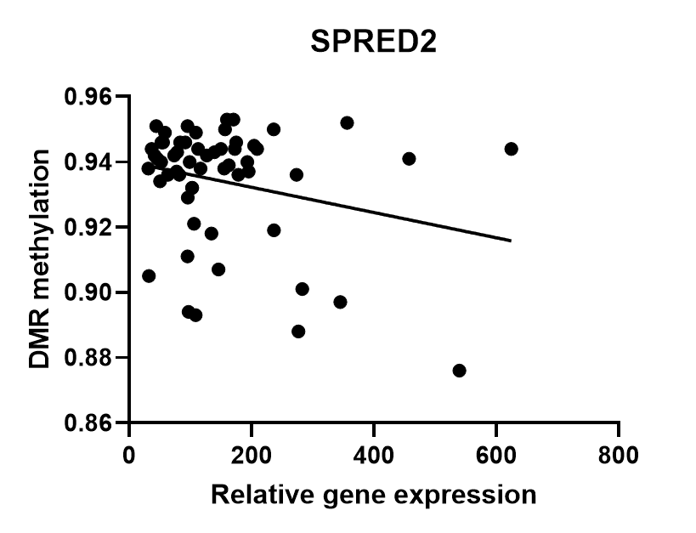
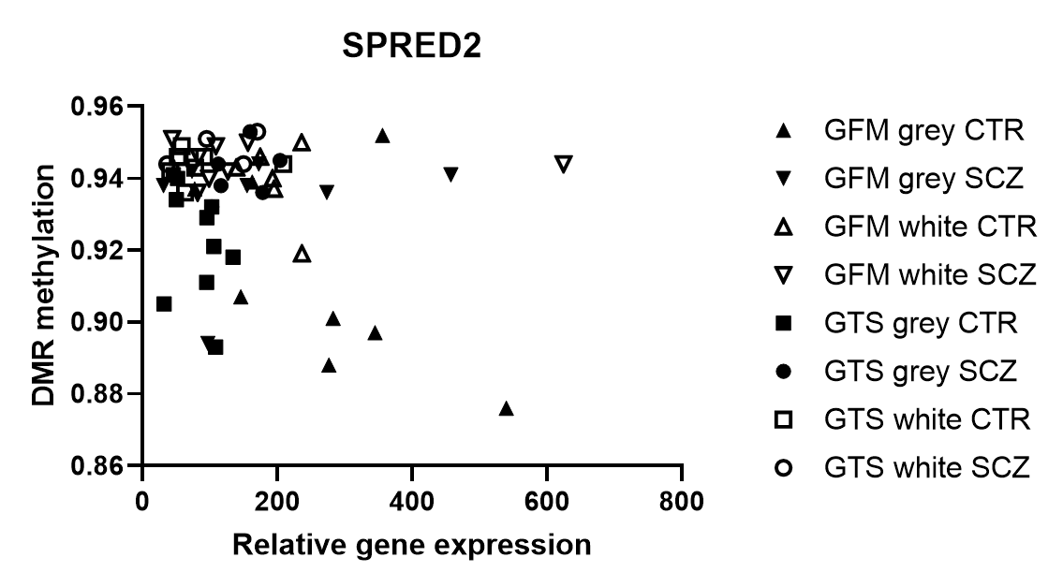
A
D
r = -0.2
B
E
r = -0.05
C
F
r = -0.07
Supplementary figure 3: Association between gene expression and DMR methylation in grey and white matter of the GFM and GTS in SCZ and CTR. (A-C) Linear regression was performed to assess the association between the degree of DMR methylation and gene expression in the gyrus frontalis medialis and gyrus temporalis superior for all donors. r = Spearman’s rho correlation. (D-F) DMR methylation and gene expression are shown separately for grey and white matter and for SCZ and CTR.

Slide 11
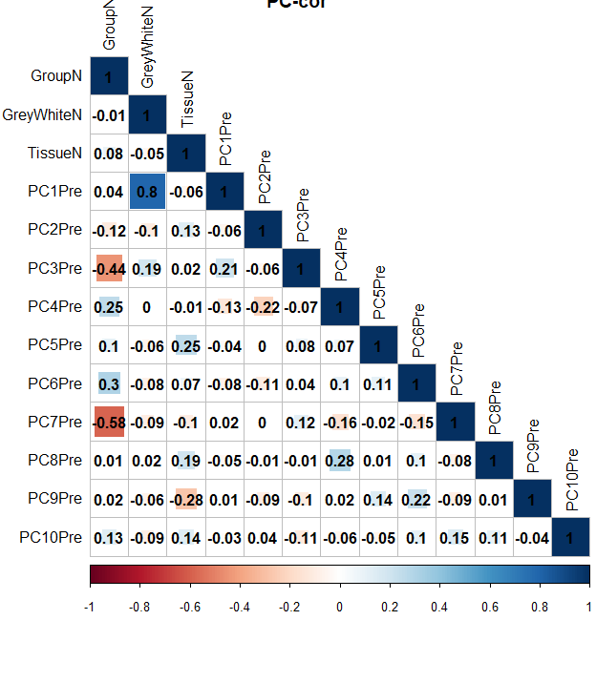
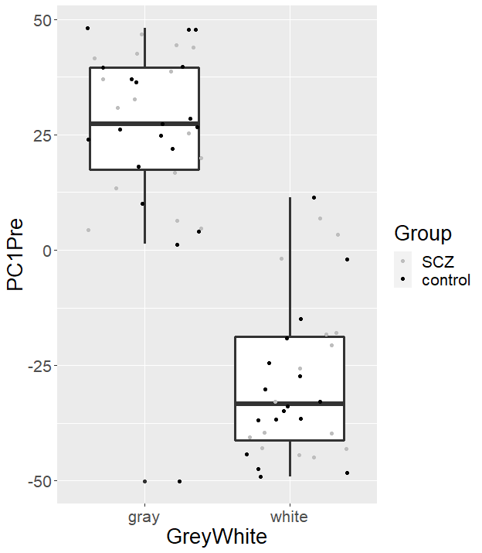
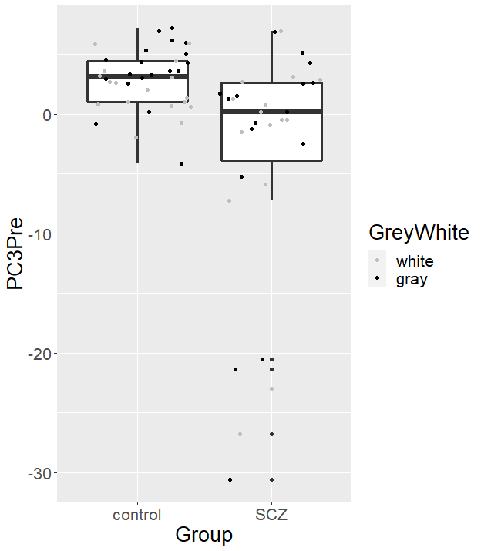
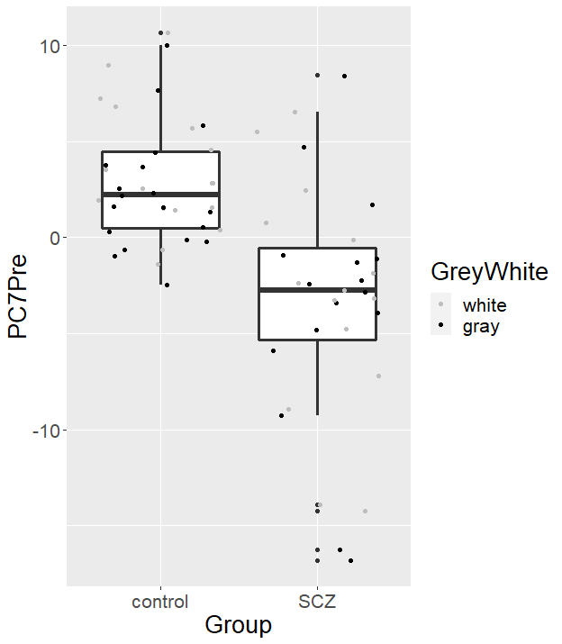
A
B
C
D
Supplementary figure 4: Principal component analysis of the DMR methylation changes. (A) We performed correlation analyses with the first 10 principal components, group (SCZ or CTR), tissue type (grey or white matter), and region (GTS or GFM). We found that PC1 was associated with the tissue type (grey-white matter), and PC3 and PC7 were associated with the disease status, shown in B-D.

Slide 12
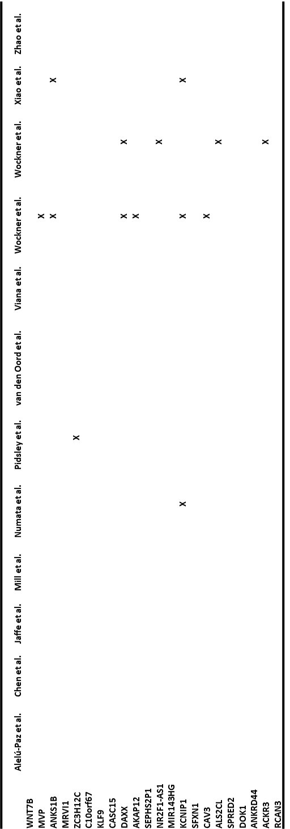
Supplementary table 8: Overlap with CPGs or DMRs in previous genome-wide DNA methylation studies of SCZ. The table shows if CPGs or DMRs associated to the genes identified with our DMR analysis were previously found in other genome wide DNA methylation studies of SCZ in prefrontal cortex tissue (indicated with X). Two DMRs from our study are not included because they could not be annotated.

