Slide 1
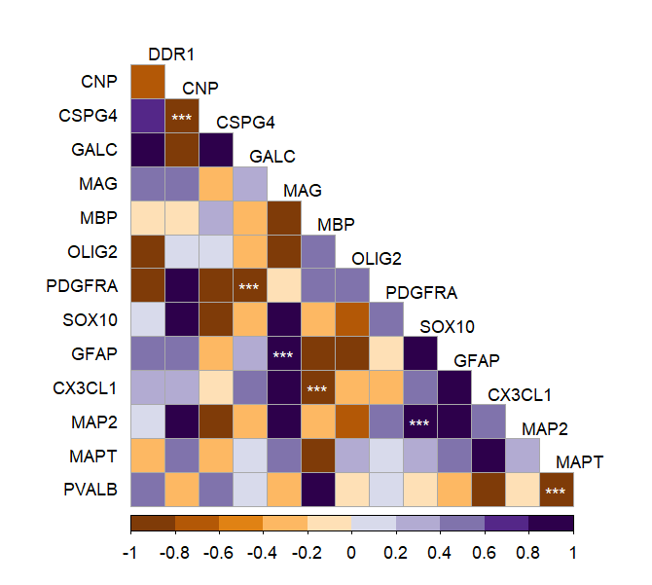
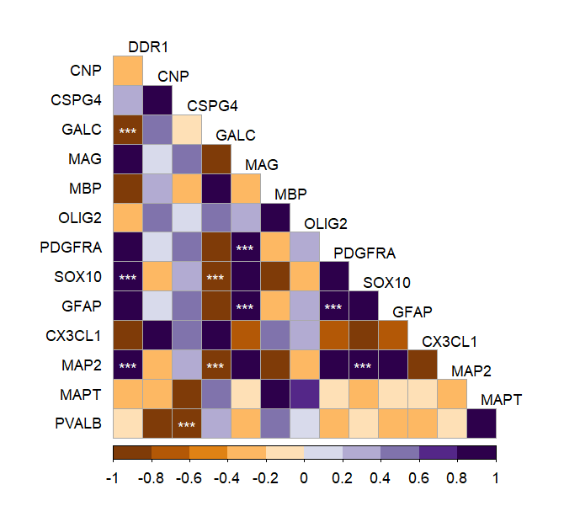
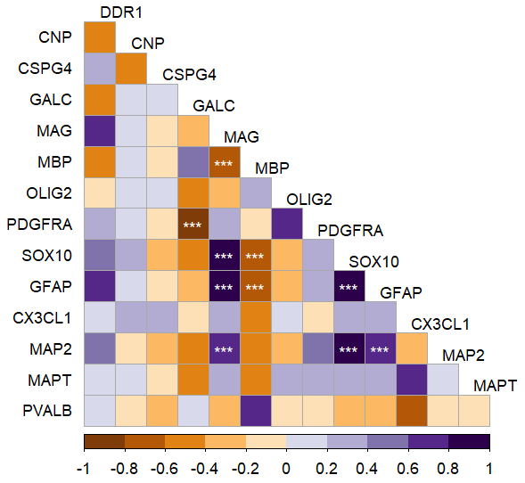
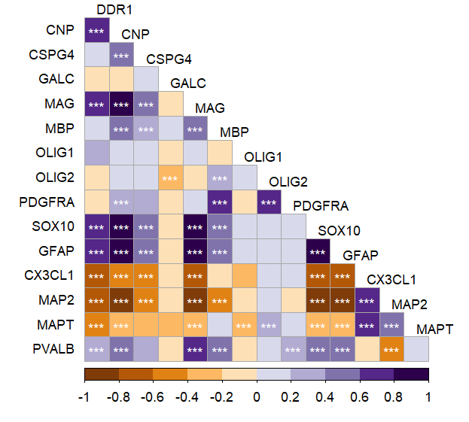
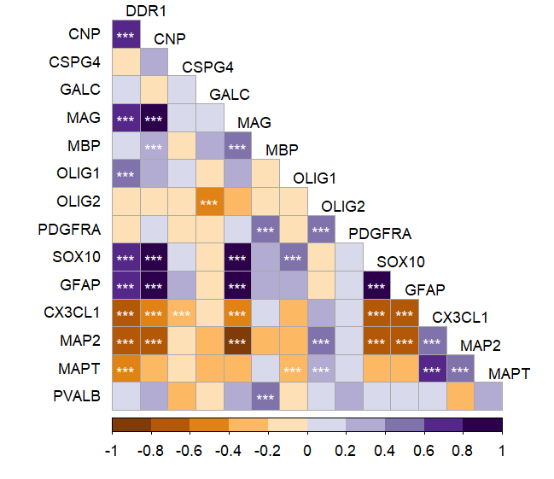
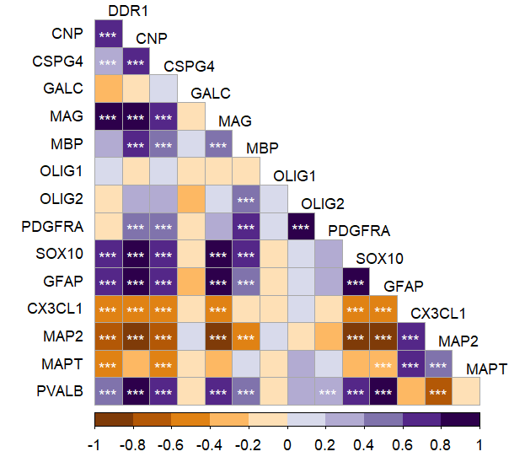
TOTAL
HC
BD
DLPFC
NeuN+
 | Astrocytes
 | Microglia
 | Neurons
 | Oligodendrocytes
Notes:
Figure S2. Comethylation of DDR1 with conventional brain cell type gene markers in DLPFC and NeuN+ tissues from patients with BD and HCs.
Correlograms for the average methylation levels between DDR1 and conventional oligodendrocyte and myelin genes and gene markers for astrocytes, microglia, and neurons in OC tissues. Each significant p-value after adjustment by the BH method (FDR 0.05) is associated with a symbol (***p<0.001, **p<0.01, *p<0.05).
Abbreviations: DLPFC: Dorsolateral prefrontal cortex; NeuN+: Neuronal nuclei; 5-mC: 5-methylcytosine; HC: Healthy controls; BD: Bipolar disorder; BH: Benjamini & Hochberg method; FDR: False discovery rate.

Slide 2
Figure S2. Comethylation of DDR1 with conventional brain cell type gene markers in DLPFC and NeuN+ tissues from patients with BD and HCs.
Correlograms for the average methylation levels between DDR1 and conventional oligodendrocyte and myelin genes and gene markers for astrocytes, microglia, and neurons in OC tissues. Each significant p-value after adjustment by the BH method (FDR 0.05) is associated with a symbol (***p<0.001, **p<0.01, *p<0.05).
Abbreviations: DLPFC: Dorsolateral prefrontal cortex; NeuN+: Neuronal nuclei; 5-mC: 5-methylcytosine; HC: Healthy controls; BD: Bipolar disorder; BH: Benjamini & Hochberg method; FDR: False discovery rate.

